Slide 1

INTRODUCTION TO SQL SERVER

Slide 2
What is Function SQL Server
Functions in SQL Server are similar to functions in other programming languages. Functions in SQL Server contains SQL statements that perform some specific tasks. Functions can have input parameters and must return a single value or multiple records.
If your scripts use the same set of SQL statements repeatedly then this can be converted into a function in the database.
SQL server functions are pre-built actions that perform calculations, manipulate data, and return results. At the most fundamental level, these functions simplify complex queries and automate repetitive tasks.
Common SQL functions include string, numeric, date/time, conditional, and aggregate functions. These functions give users the ability to extract and analyze data from massive databases efficiently and effectively.

Slide 3
Functions In SQL Server
Function Category | Function Name | Description
Aggregate | COUNT() | Returns the number of rows in a result set.
 | SUM() | Calculates the sum of values in a column.
 | AVG() | Computes the average of values in a column.
 | MIN() | Returns the minimum value in a column.
 | MAX() | Returns the maximum value in a column.
 | GROUP_CONCAT() | Concatenates strings from a group into one string.

Slide 4
Functions In SQL Server
Function Category | Function Name | Description
String | CONCAT() | Concatenates two or more strings.
 | LEN() | Returns the length of a string.
 | UPPER() / UCASE() | Converts a string to uppercase.
 | LOWER() / LCASE() | Converts a string to lowercase.
 | LEFT() | Extracts a specified number of characters from the beginning of a string.
 | RIGHT() | Extracts a specified number of characters from the end of a string.

Slide 5
Functions In SQL Server
Function Category | Function Name | Description
Date and Time | GETDATE() | Returns the current system date and time.
 | DATEPART() | Extracts a specific part of a date/time.
 | DATEADD() | Adds a specified interval to a date/time.
 | DATEDIFF() | Calculates the difference between two dates/times.
 | YEAR() | Extracts the year from a date.
 | MONTH() | Extracts the month from a date.

Slide 6
Functions In SQL Server
Function Category | Function Name | Description
Mathematical | ROUND() | Rounds a numeric value to a specified precision.
 | CEILING() | Rounds up to the nearest integer.
 | FLOOR() | Rounds down to the nearest integer.
 | ABS() | Returns the absolute value of a numeric expression.
 | POWER() | Raises a number to a specified power.
 | SQRT() | Returns the square root of a number.
https://blog.hubspot.com/website/sql-server-functions#what

Slide 7
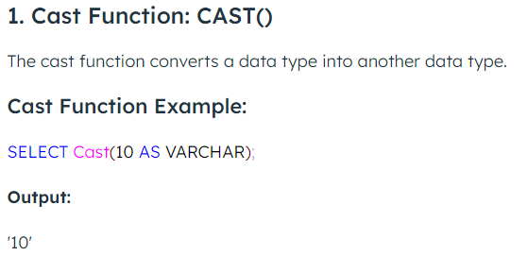
Functions In SQL Server

Slide 8
Functions In SQL Server
SELECT CAST('123' AS INT);
SELECT CAST(42.69 AS INT);
SELECT CAST(3 AS DECIMAL);
SELECT CAST('2024-12-21' AS DATE);
SELECT CAST(42 AS CHAR)

Slide 9
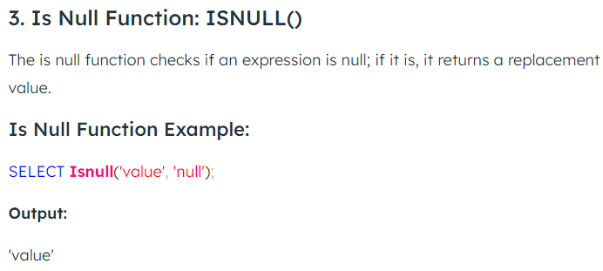
Functions In SQL Server

Slide 10
CREATE TABLE Employee
(EmployeeID INT IDENTITY(1, 1) NOT NULL,
EmployeeName VARCHAR(50) NOT NULL,
EmployeeSalary INT NULL
);
INSERT INTO Employee
(EmployeeName,
EmployeeSalary
)
VALUES
('Rajendra',
55645
);
INSERT INTO Employee(EmployeeName)
VALUES('Rajendra');
SELECT * FROM Employee
SELECT ISNULL(NULL, 100) result;
SELECT ISNULL(NULL, 'SQLServer')
SELECT ISNULL('SQLShack', 'SQLServer')
SELECT Employeeid, EmployeeName , EmployeeSalary,
ISNULL(EmployeeSalary, 10000) AS eMP
FROM Employee;

Slide 11
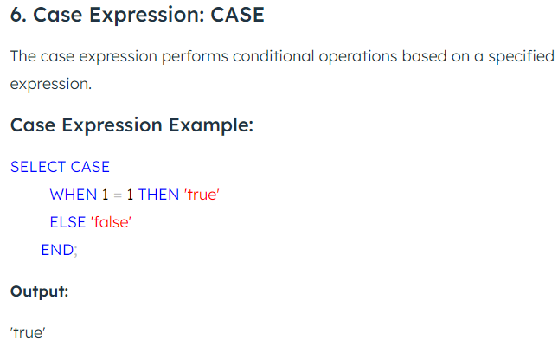
Functions In SQL Server

Slide 12
CREATE TABLE Customer(
CustomerID INT PRIMARY KEY,
CustomerName VARCHAR(50),
LastName VARCHAR(50),
Country VARCHAR(50),
Age int(2),
Phone int(10)
);
-- Insert some sample data into the Customers table
INSERT INTO Customer (CustomerID, CustomerName, LastName, Country, Age, Phone)
VALUES (1, 'Shubham', 'Thakur', 'India','23','xxxxxxxxxx'),
(2, 'Aman ', 'Chopra', 'Australia','21','xxxxxxxxxx'),
(3, 'Naveen', 'Tulasi', 'Sri lanka','24','xxxxxxxxxx'),
(4, 'Aditya', 'Arpan', 'Austria','21','xxxxxxxxxx'),
(5, 'Nishant. Salchichas S.A.', 'Jain', 'Spain','22','xxxxxxxxxx');

Slide 13
SELECT CustomerName, Age,
CASE
WHEN Age> 22 THEN 'The Age is greater than 22'
WHEN Age = 21 THEN 'The Age is 21'
ELSE 'The Age is over 30'
END AS QuantityText
FROM Customer;
SELECT CustomerName, Age,
CASE
WHEN Country = "India" THEN 'Indian'
ELSE 'Foreign'
END AS Nationality
FROM Customer;

Slide 14
SELECT CustomerName, Country
FROM Customer
ORDER BY
(CASE
WHEN Country IS 'India' THEN Country
ELSE Age
END);

Slide 15
SELECT order_id, customer_id,
CASE
WHEN amount >= 400 THEN (amount - amount * 10/100)
END AS offer_price
FROM Orders;
SELECT customer_id, first_name,
CASE
WHEN age >= 18 THEN 'Allowed'
END AS can_vote
FROM Customers;

Slide 16
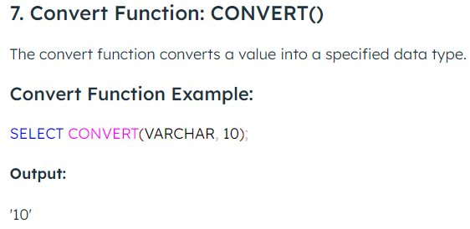
Functions In SQL Server

Slide 17
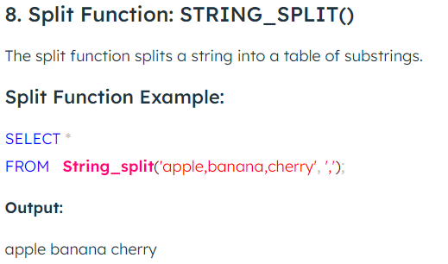
Functions In SQL Server

Slide 18
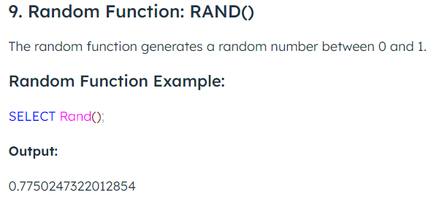
Functions In SQL Server

Slide 19
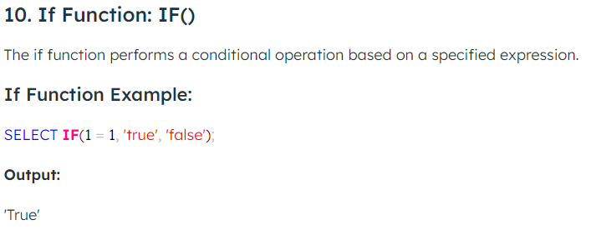
Functions In SQL Server

Slide 20
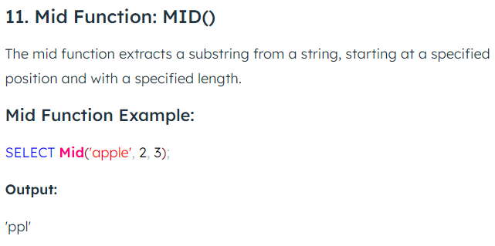
Functions In SQL Server

Slide 21
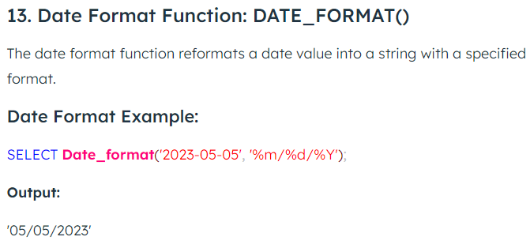
Functions In SQL Server

Slide 22
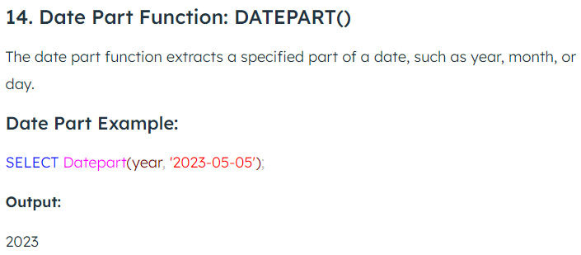
Functions In SQL Server

Slide 23
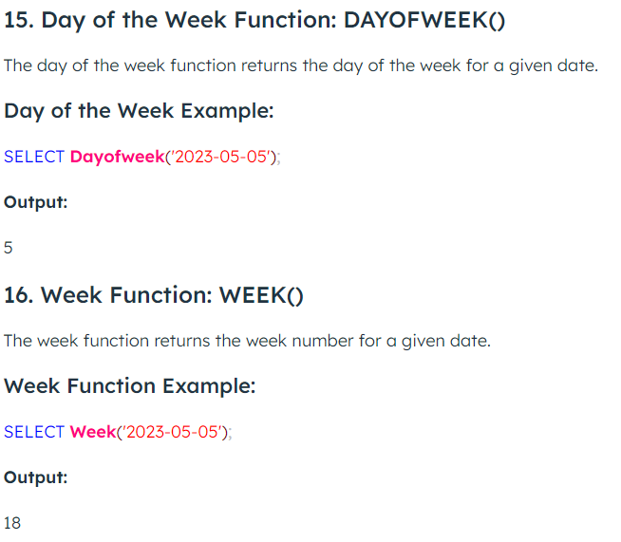
Functions In SQL Server

Slide 24
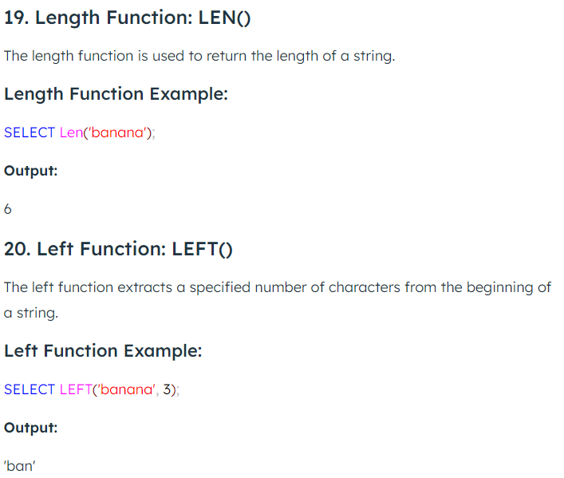
Functions In SQL Server

Slide 25
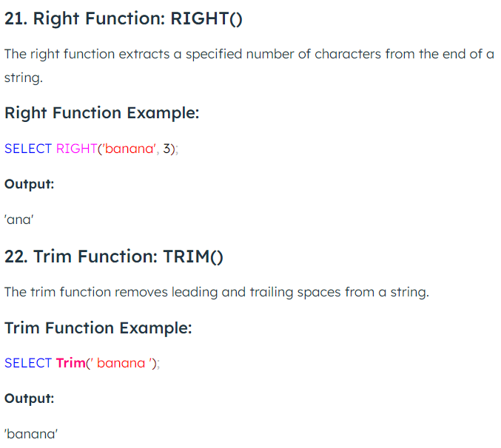
Functions In SQL Server

Slide 26
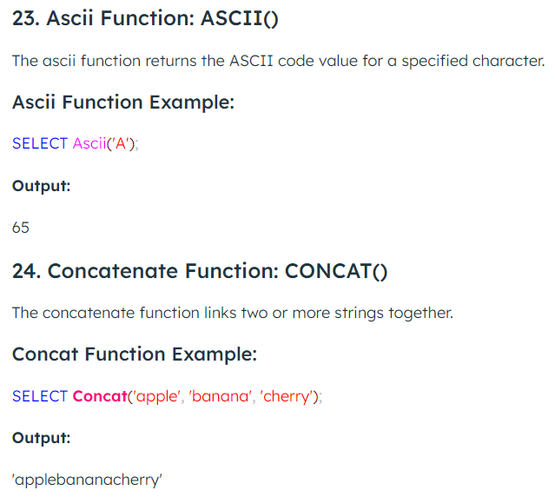
Functions In SQL Server

Slide 27
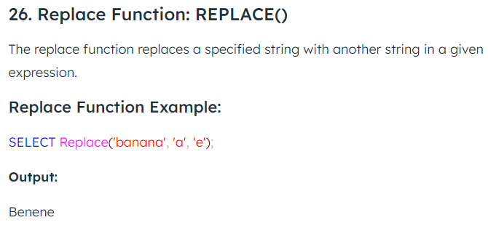
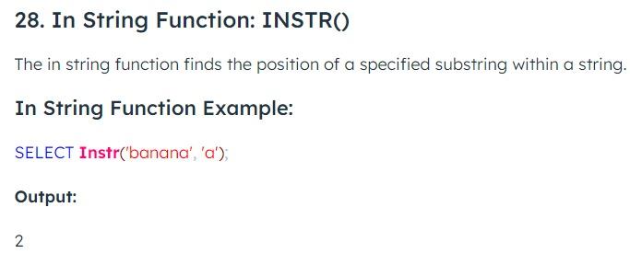
Functions In SQL Server

